Slide 1
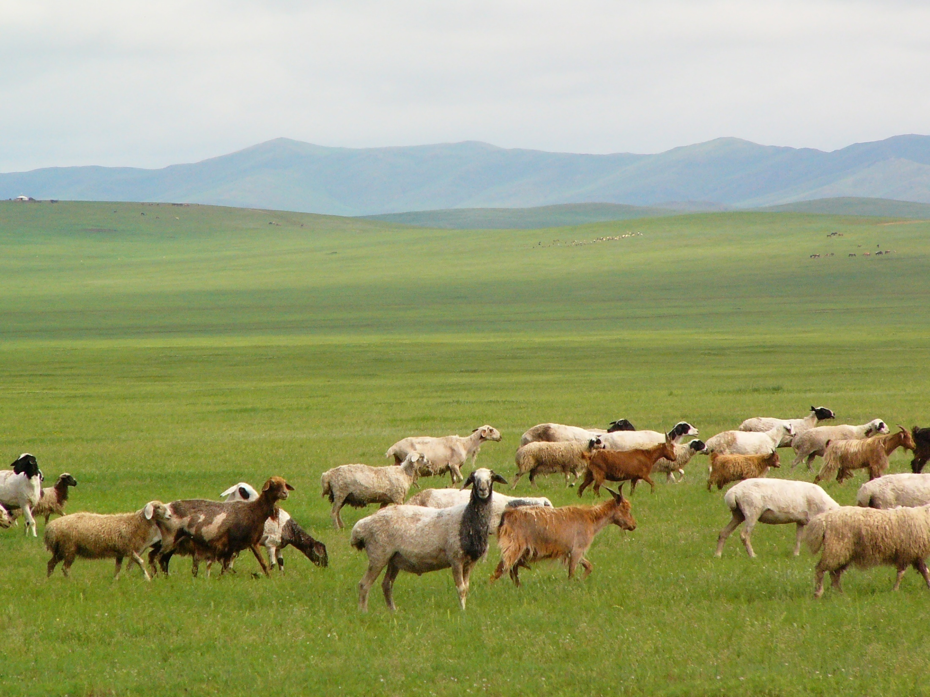

2014 Annual Report
“he made himself nothing
by taking the very nature of a servant,
being made in human likeness.”
Philippians 2:7
Mongolia UBF

Slide 2

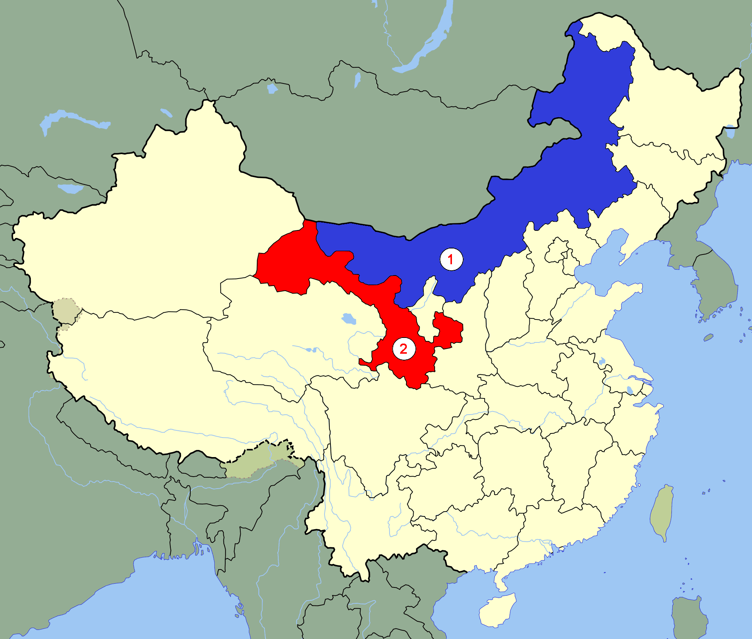
World Mission
Inner Mongolia
(Khukh Khot)
3 missionaries
2. Gansu
(Lanzhou)
2 missoinaries

Slide 3
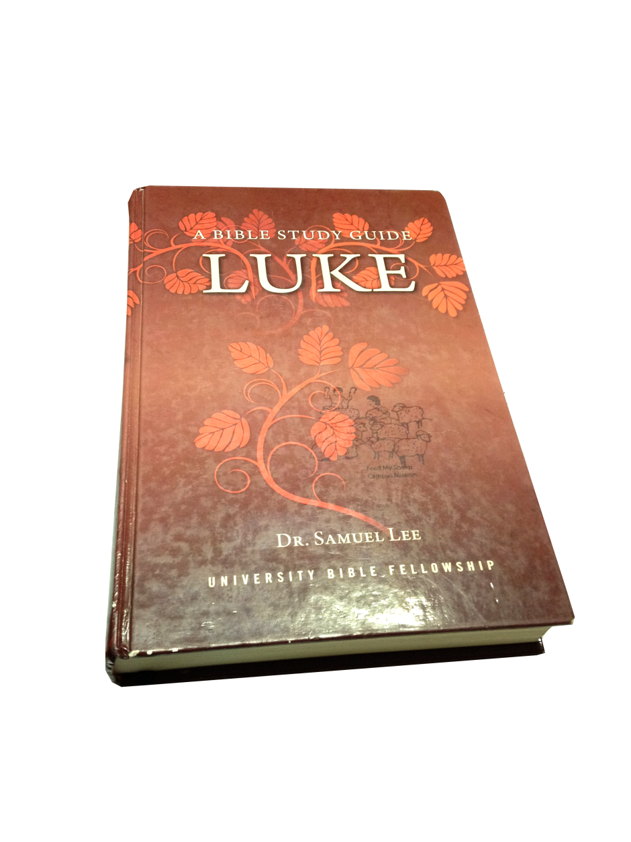
Words of God
NUM Chapter
I, II Samuel
Acts
Ephesians
John
West UB Chapter
Luke
“You give them something to eat”
Luke 9:13

Slide 4
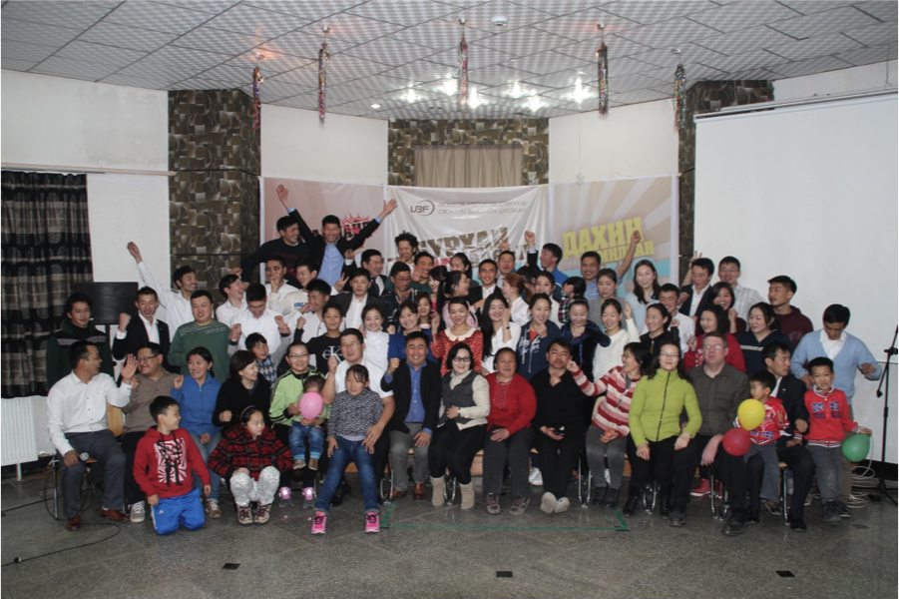
Spring Conference
NUM 4.18-20

Slide 5
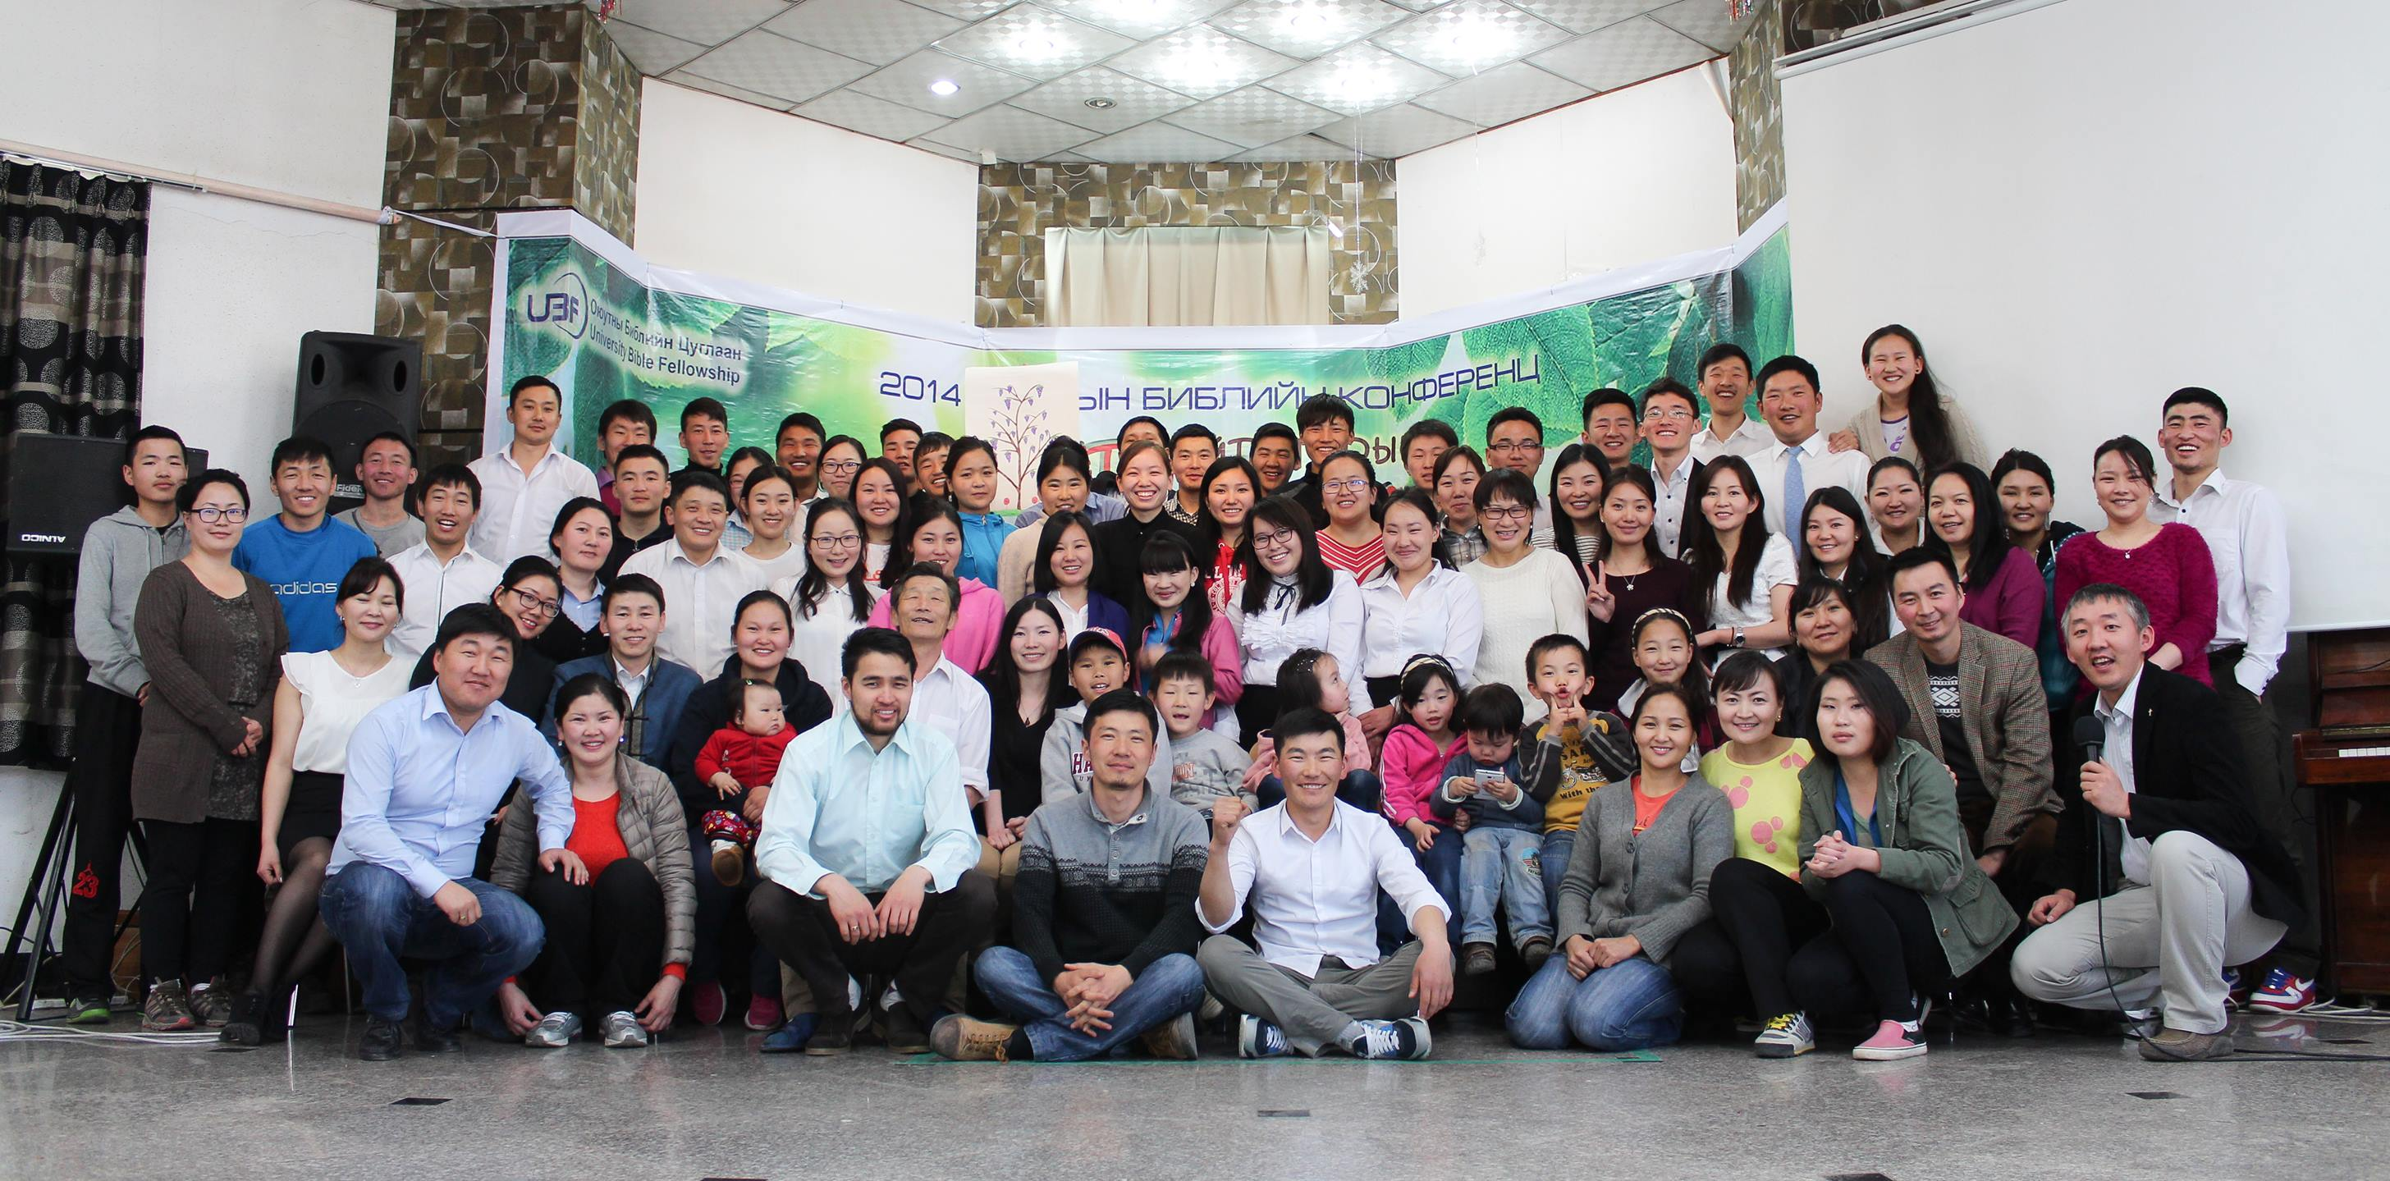
EAST UB 4.25-27
Spring Conference

Slide 6
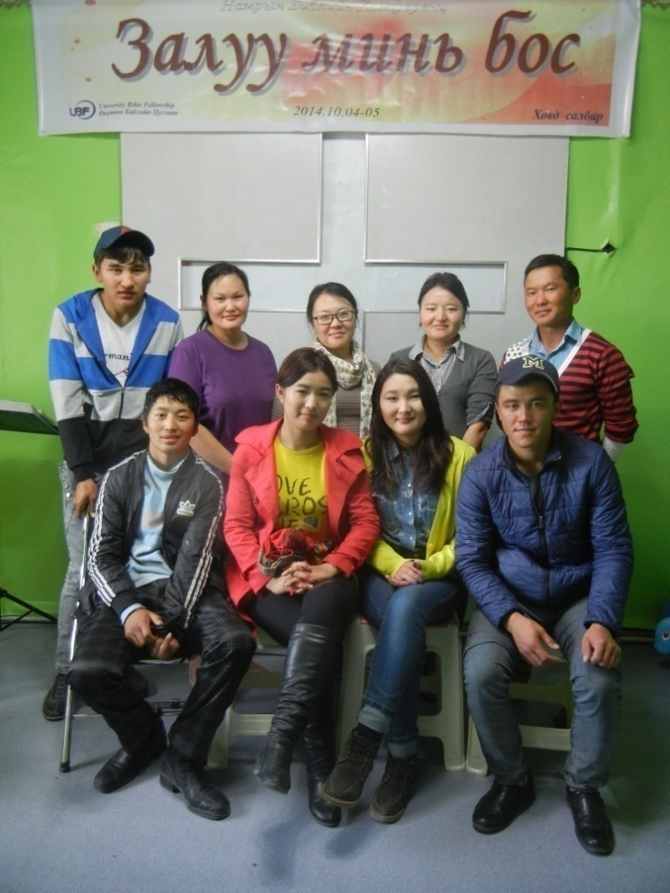
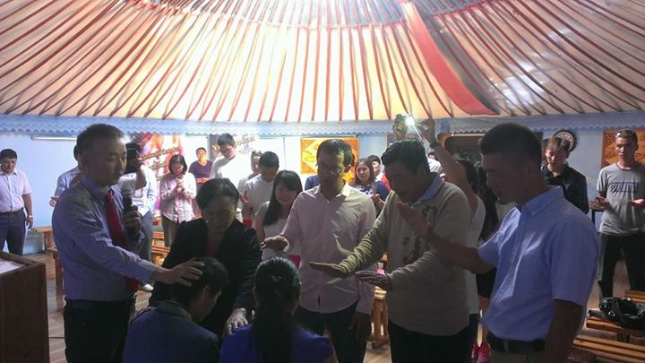
Khovd Chapter

Slide 7
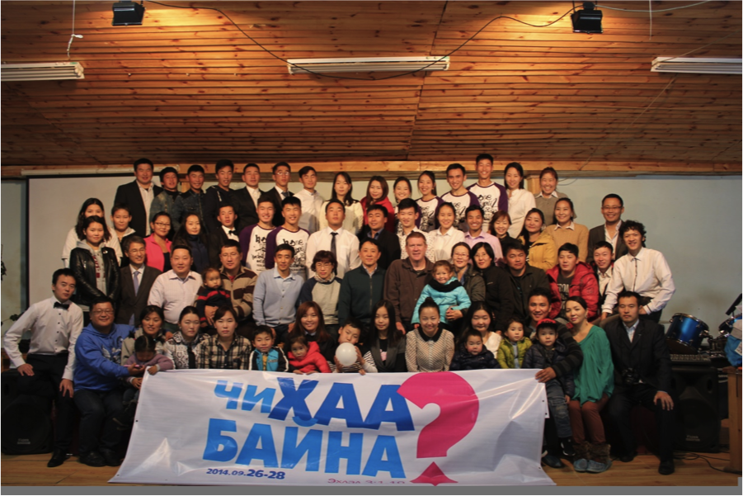
Autumn Conference
NUM 9.26-28

Slide 8
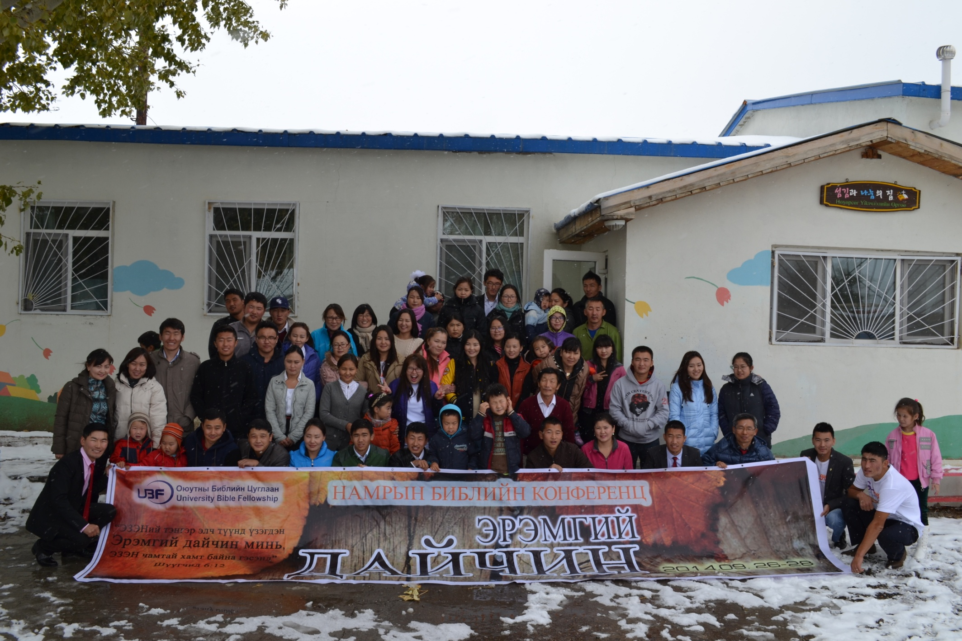
Autumn Conference
Autumn Conference
EAST 9.26-28

Slide 9
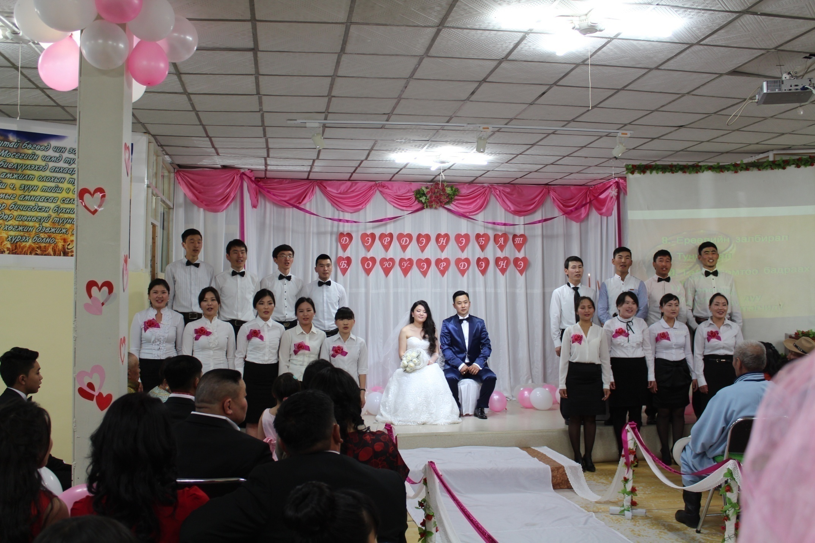
Erdenebat & Oyu-Erdene (East UB) 5.30

Slide 10
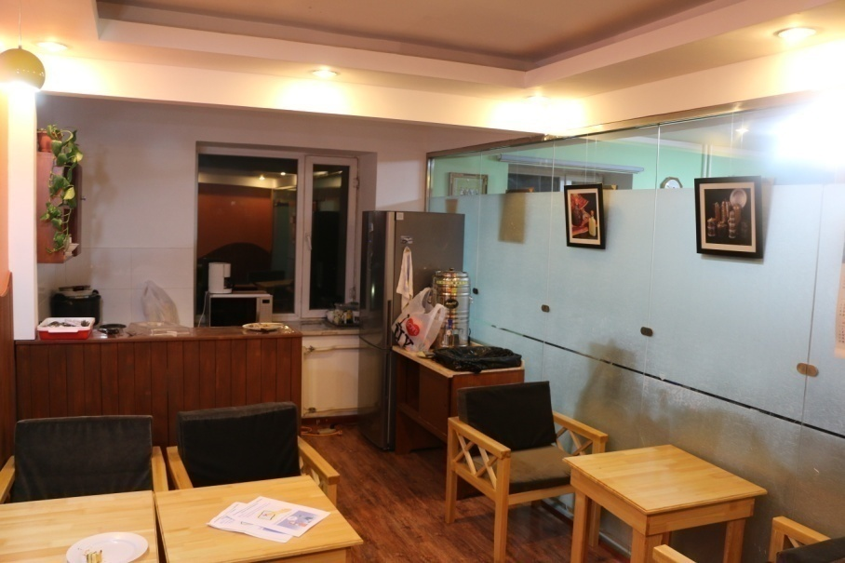
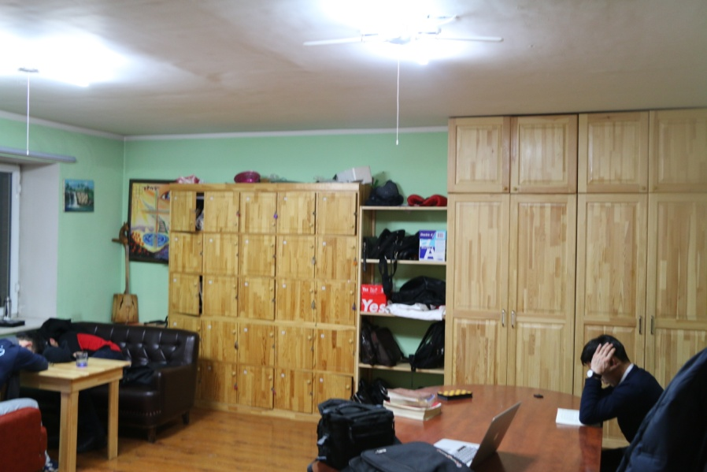
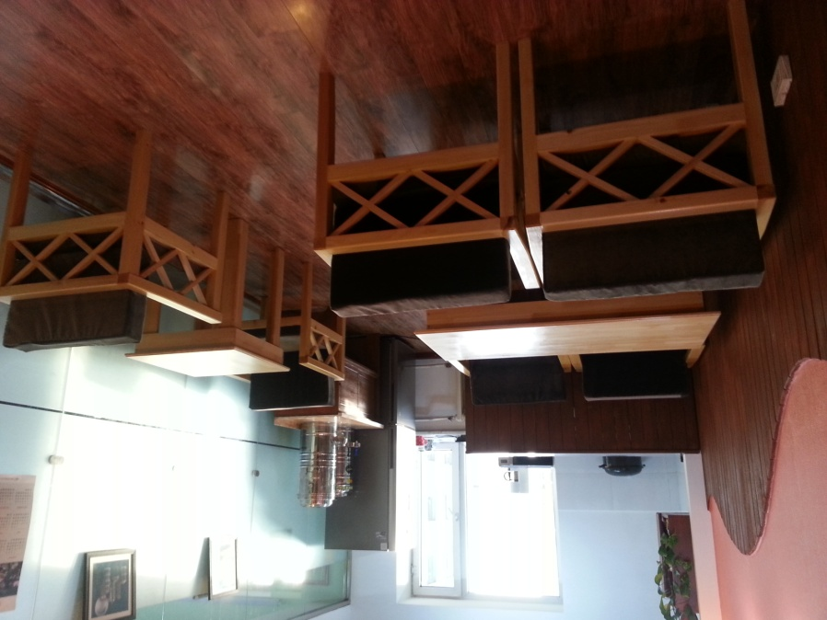
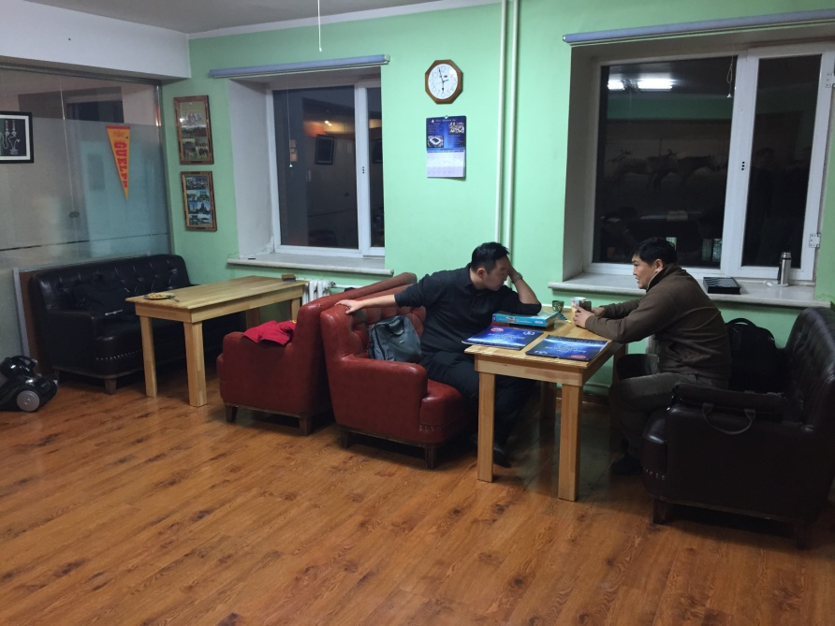
Cafe The men’s room
West UB

Slide 11
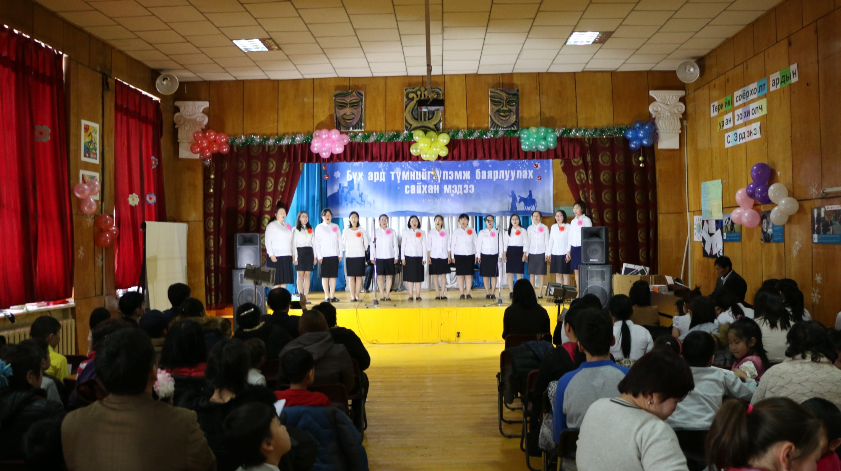
Christmas Worship (West UB)
12.24

Slide 12
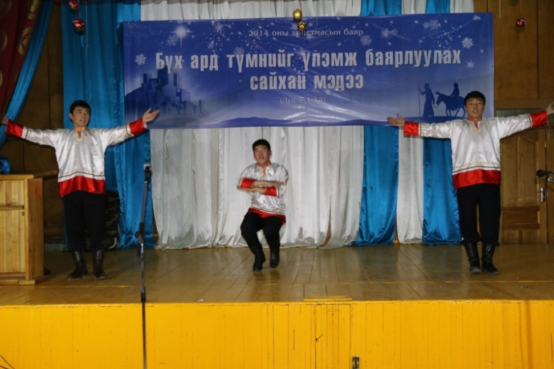
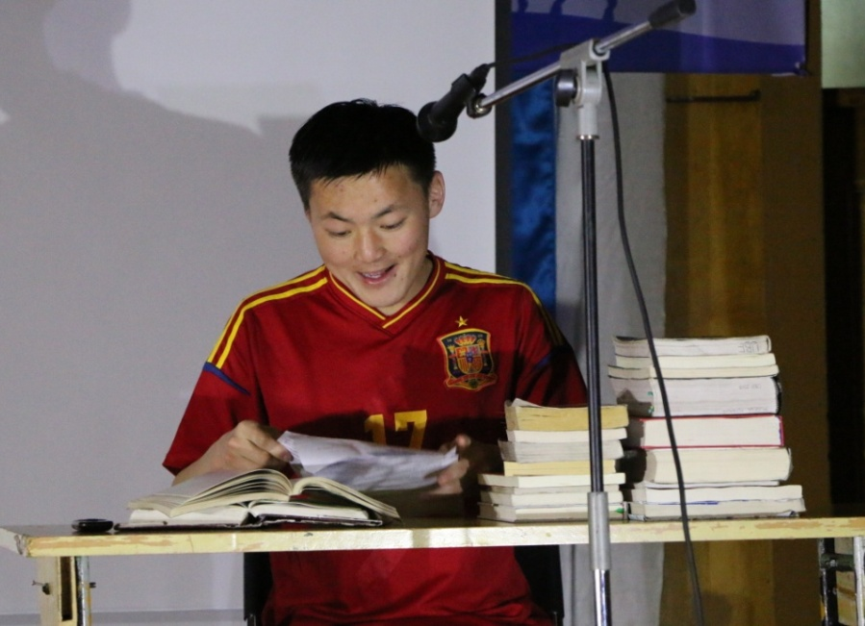
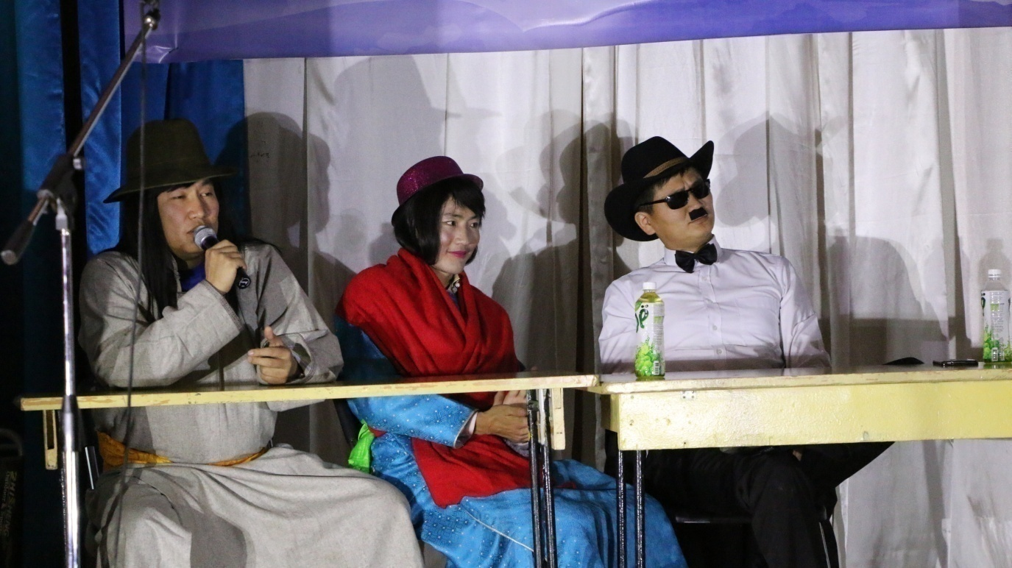
Christmas Carol, Drama, Russian Dance

Slide 13
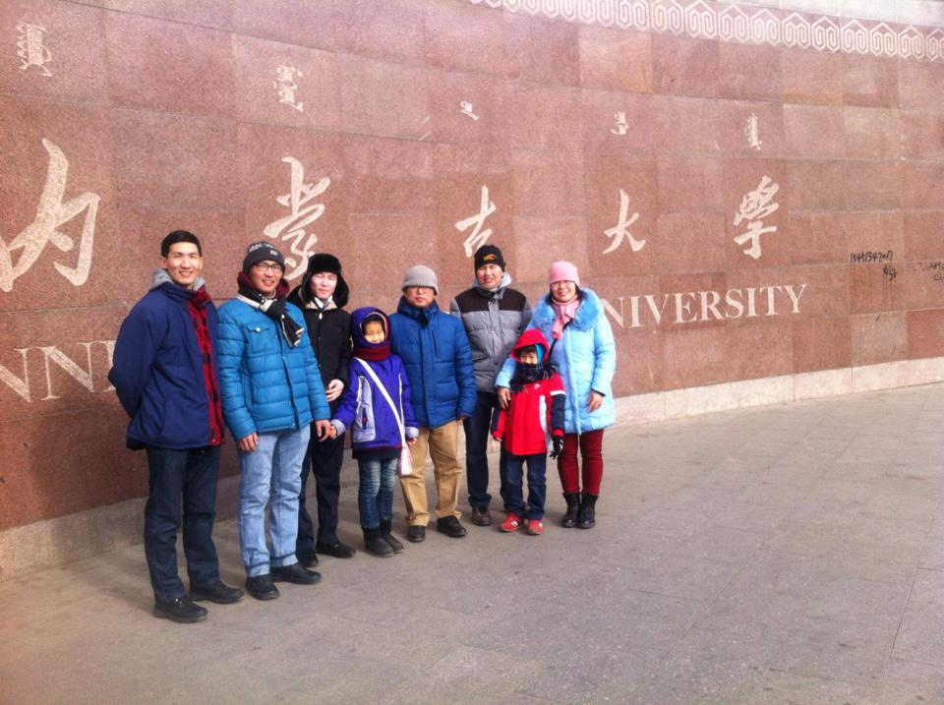
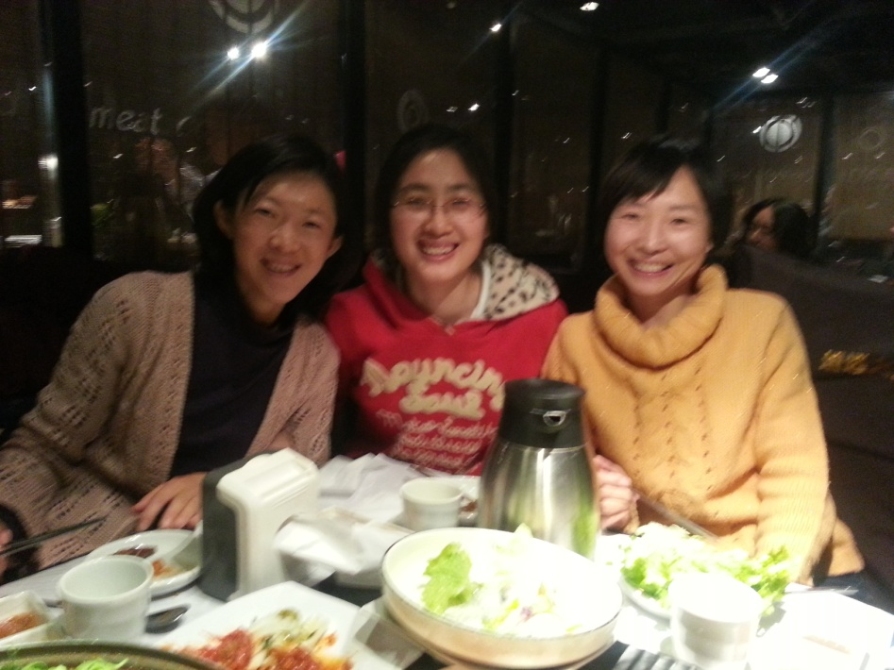
Christmas Party with co workers

Slide 14
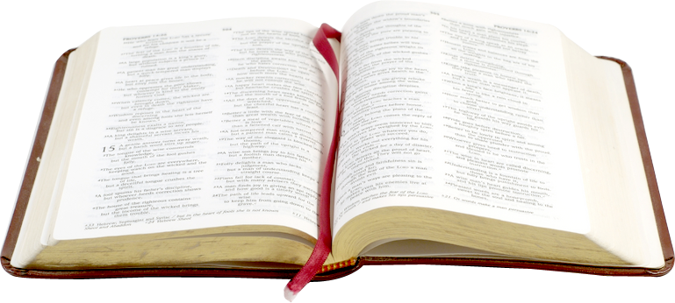
2015 My key verse
“What you heard from me, keep as the pattern of sound teaching, with faith and love in Christ Jesus. Guard the good deposit that was entrusted to you – guard it with help of the Holy Spirit who lives in us.
2 Timothy 1:13,14

Slide 15
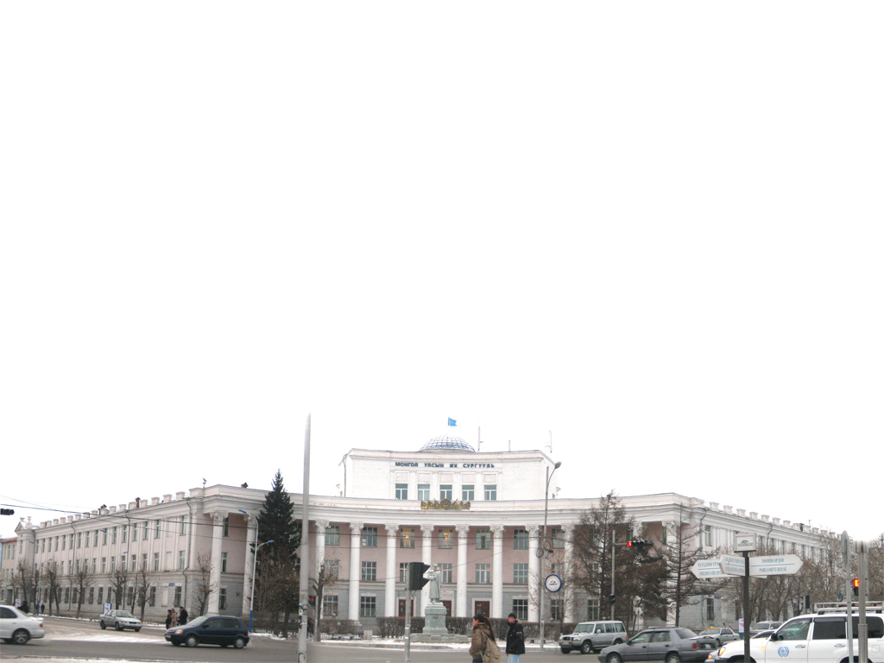
Thank You!

